Slide 1
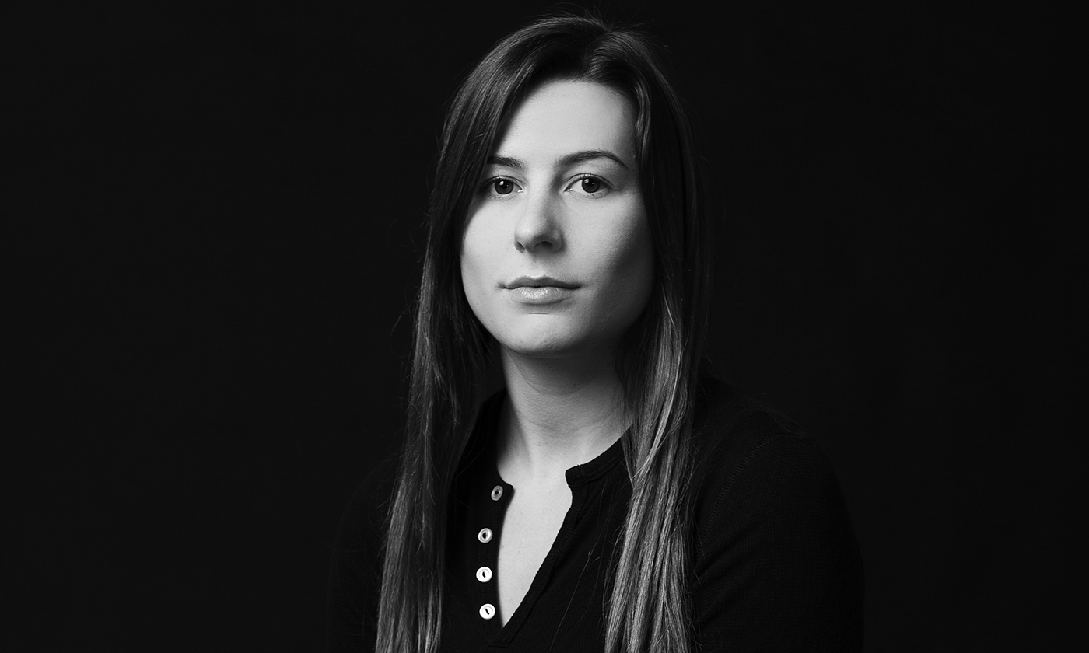
Leah Aripotch
Metal Fabrication Sculptor and Jewelry Artist
Born and raised in Montauk, New York in 1987

Slide 2
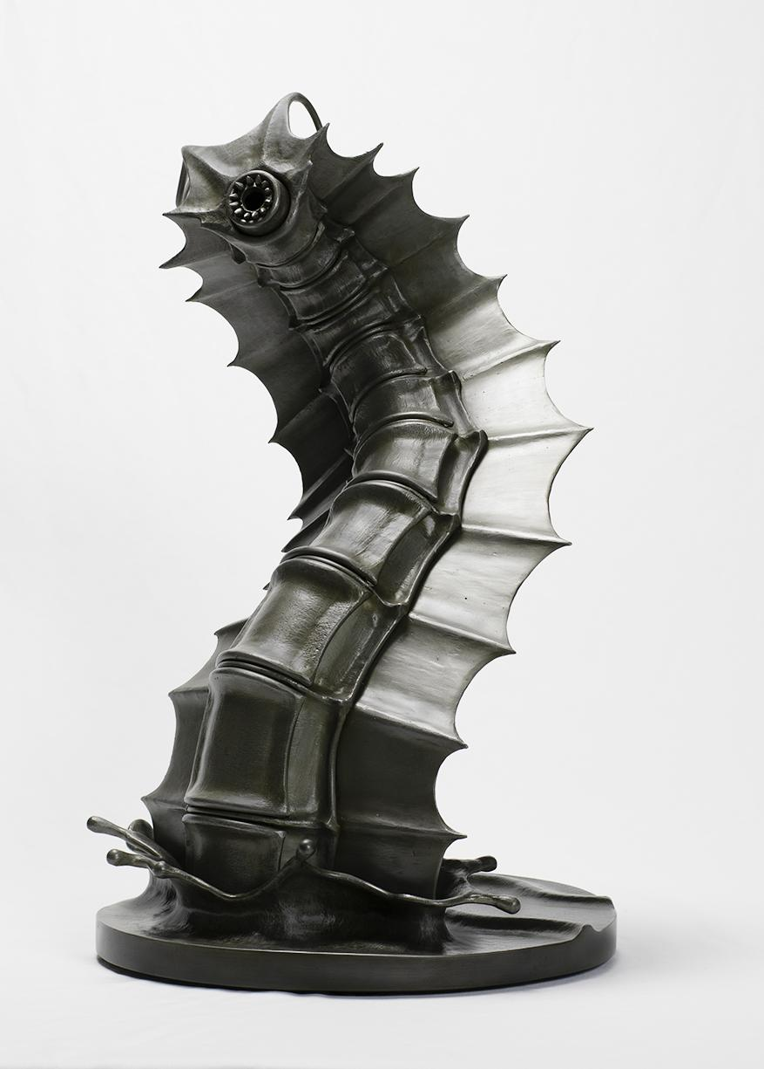
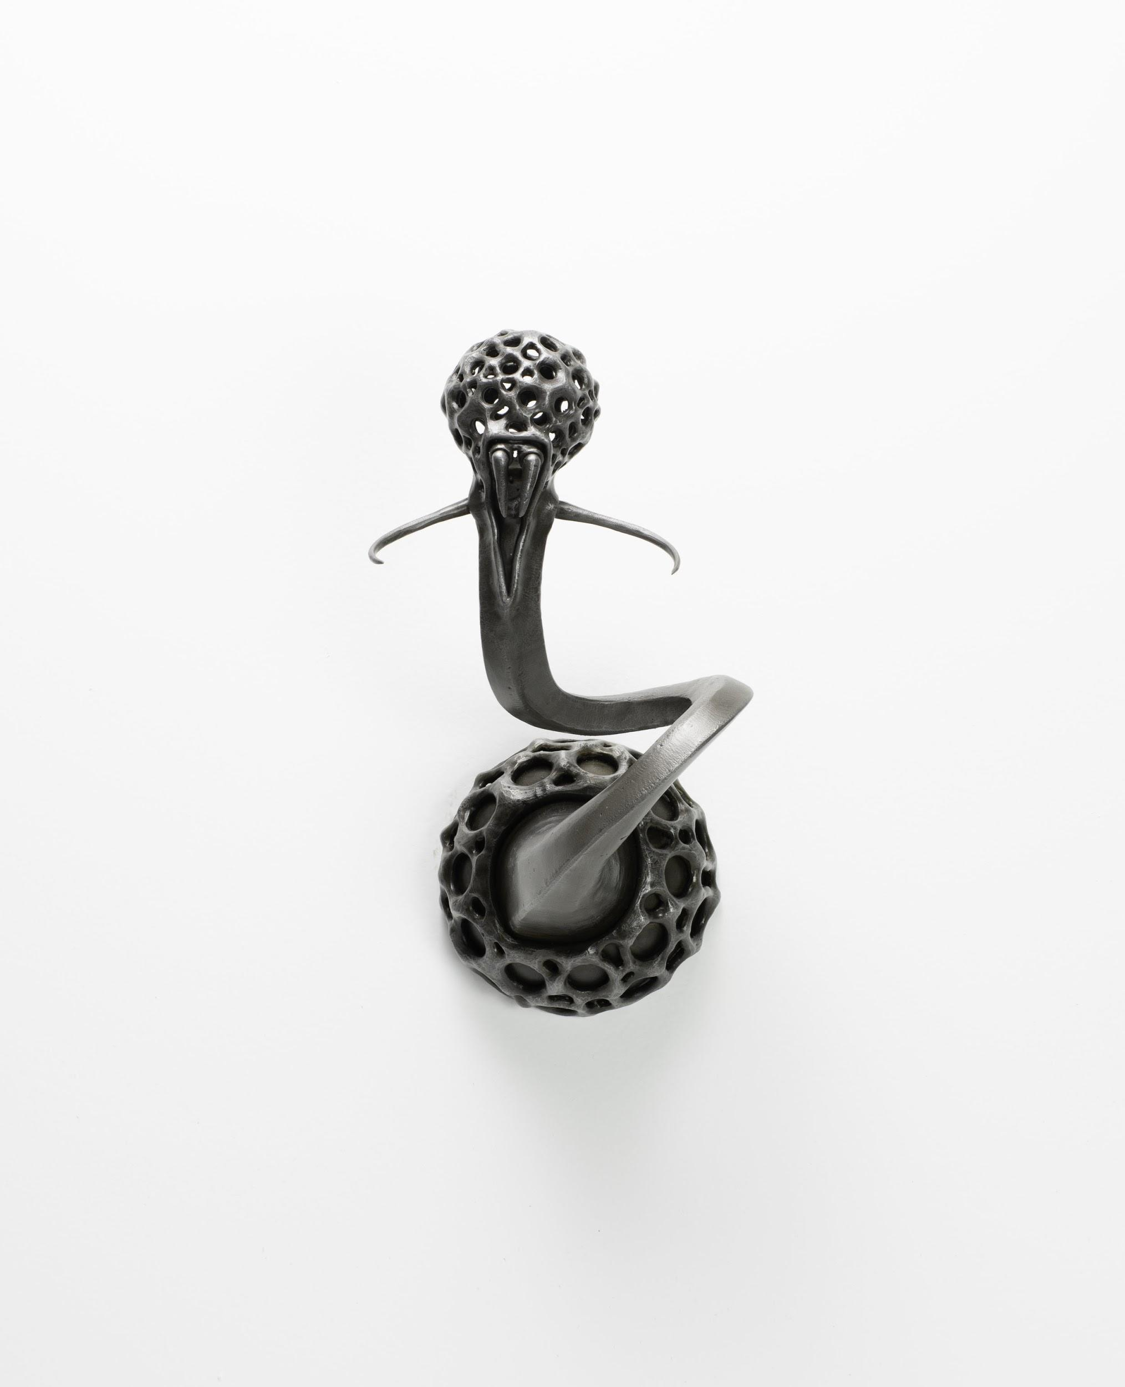
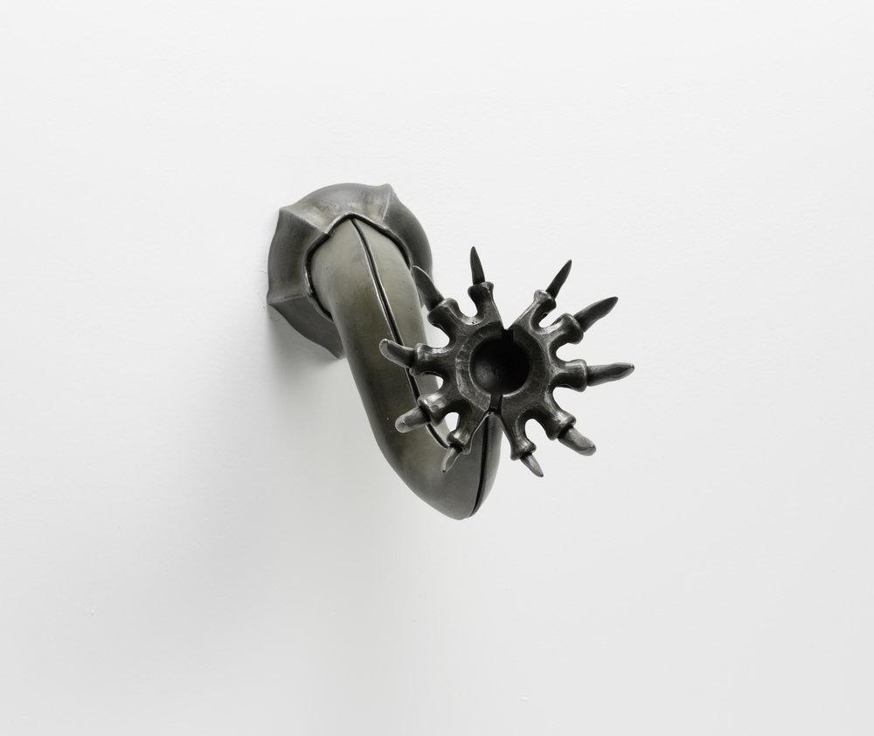
Barbara
Gary
Margo

Slide 3
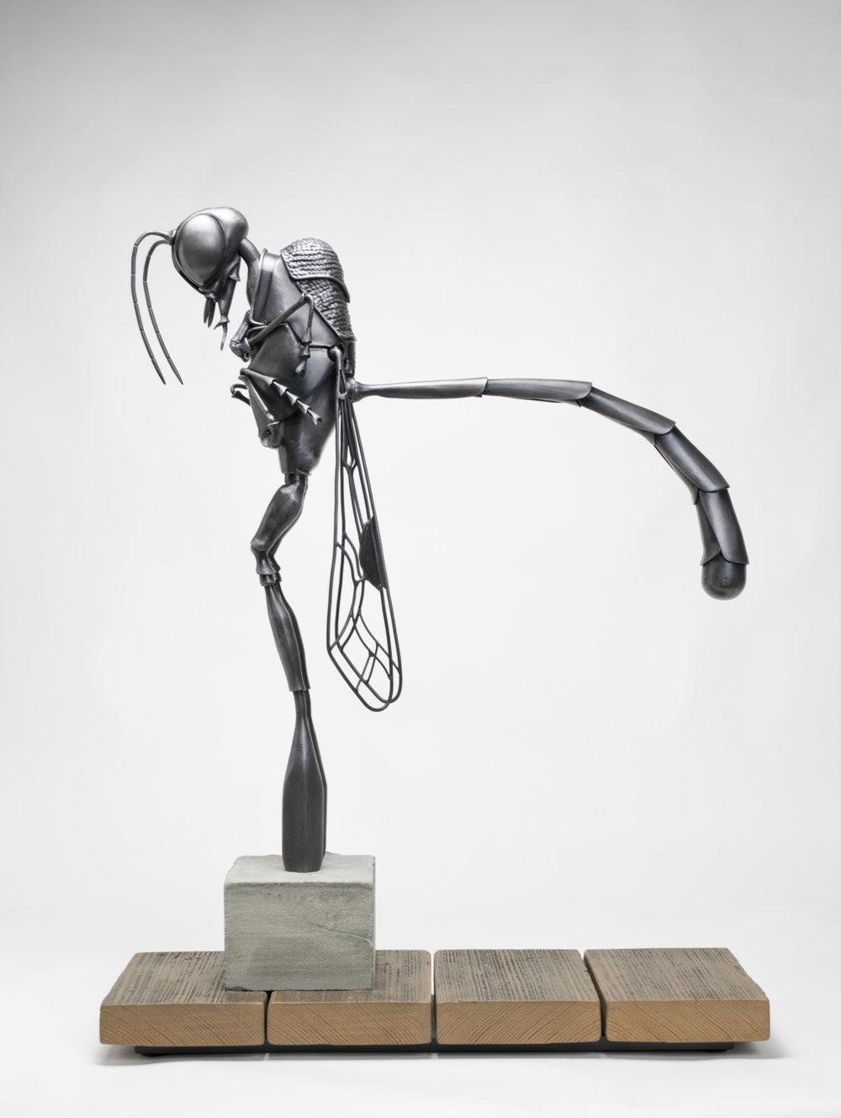

Slide 4
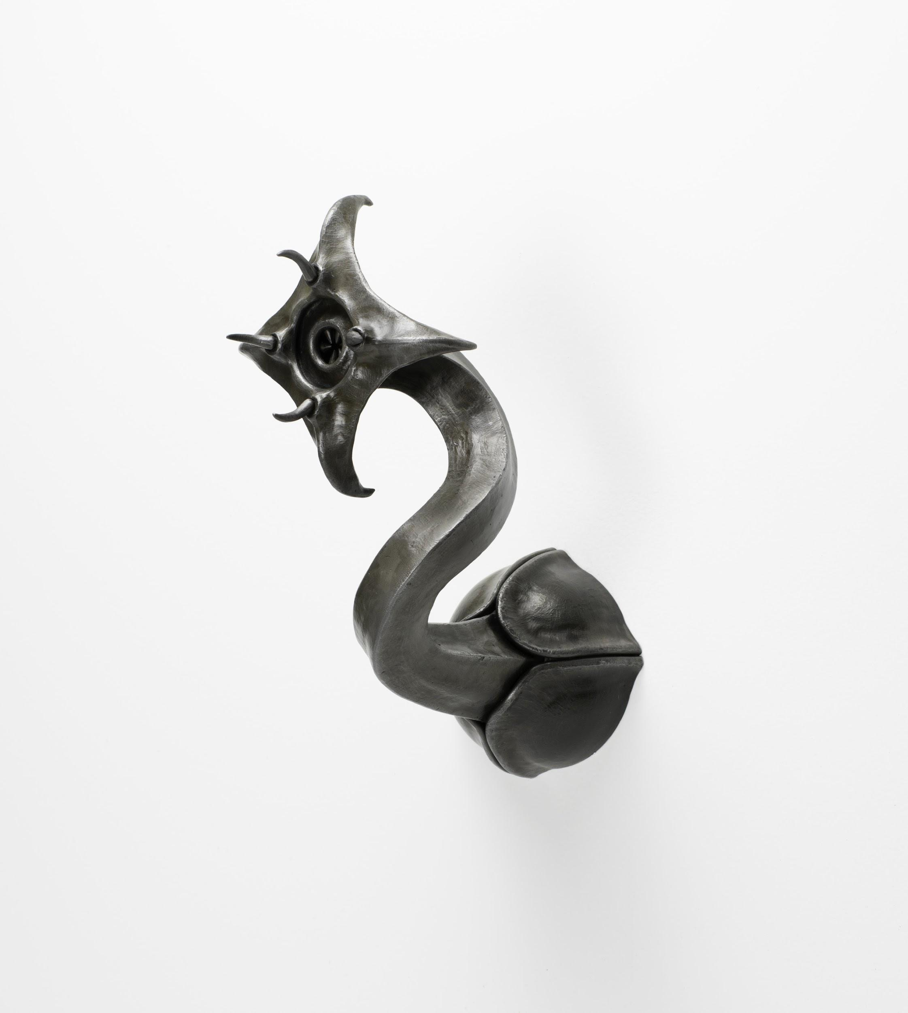
Anthropomorphism - attaching human characteristics, traits, emotion to an animal non-human object
Metal Fabrication - creation of metal structures by cutting, bending, welding, assembling
Figurative - art that portrays mainly human or animal figure
Clyde

Slide 5
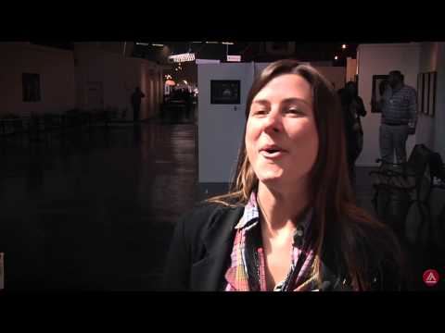

Slide 6
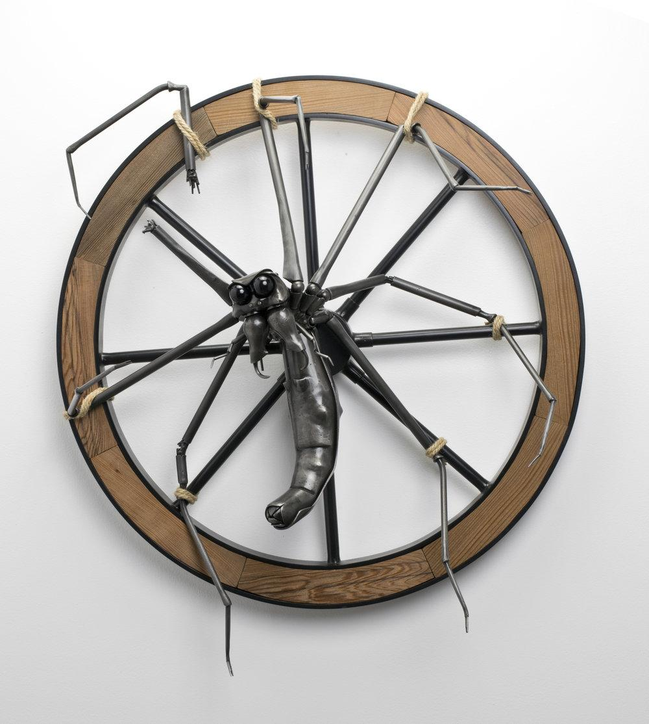
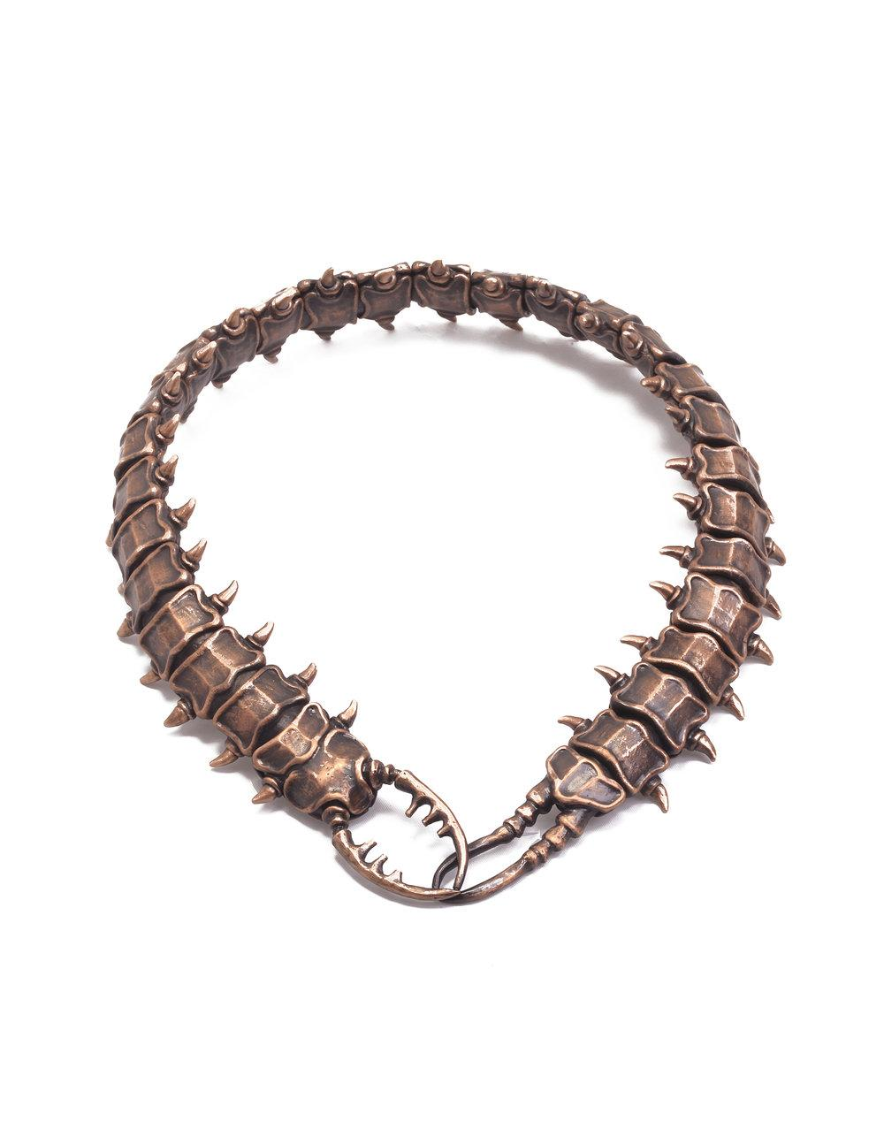
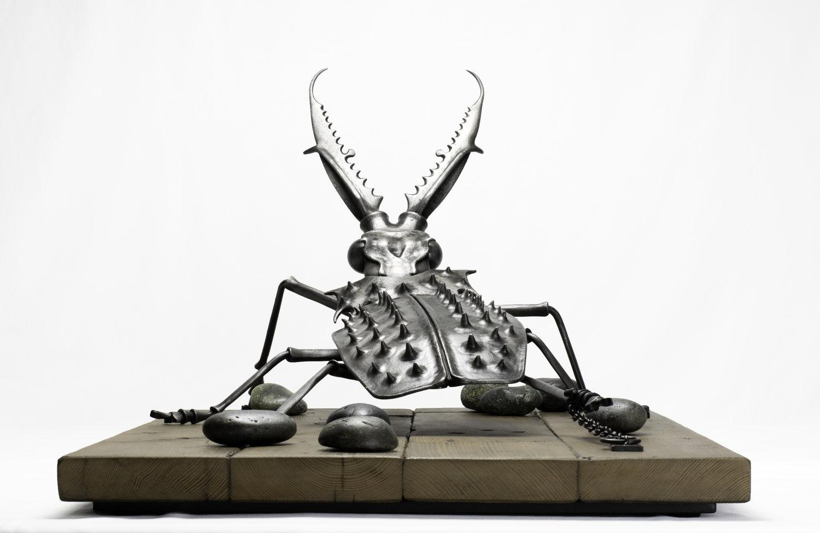
How are you inspired by this artist?

